Slide 1
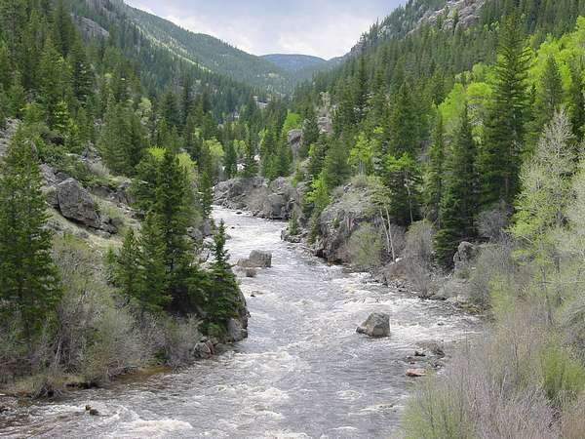
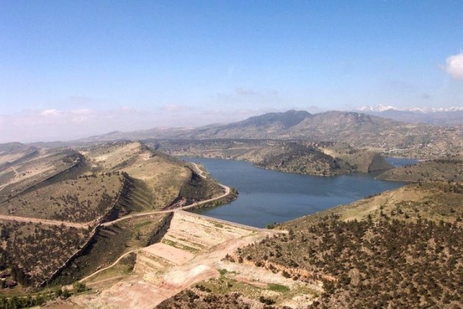
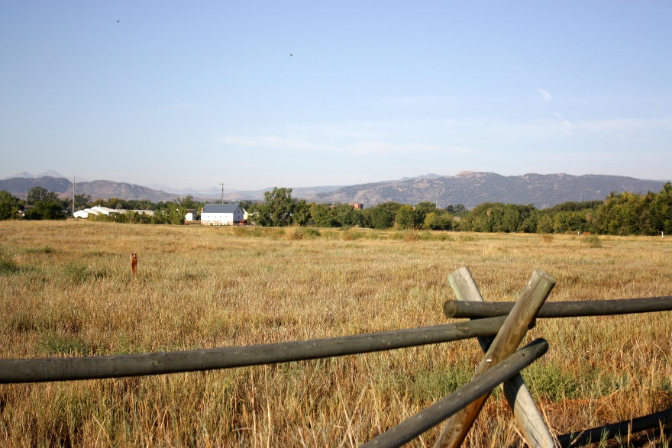
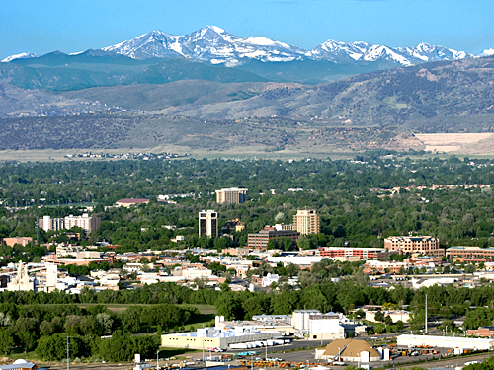
Scenario Planning for the Cache la Poudre Watershed
http://tramping-around.wikispaces.com/file/view/cache-la-poudre-river.jpg/171290119/cache-la-poudre-river.jpg
http://943loudwire.com/horsetooth-reservoir-water-level-dropping-quickly/
https://opiegp.files.wordpress.com/2012/09/img_2143.jpg
http://www.fcgov.com/visitor/galleries/foco/slide_0.jpg
Tanner Craigmile Taylor Hunter Jacqui Marquez Kris Smith Tyler Todd Savannah Warwick
NR 420 – Integrated Ecosystem Management

Slide 2
Introduction & Outline
Resilience Assessment Recap:
Geographical Area
Highlights from Key Findings
Stakeholder Analysis & Involvement Plan:
Stakeholder Description – impacts & Influence
Stakeholder Involvement Plan
Scenario Management Plan:
Focal Question, Driving Forces & Uncertainties
Scenario Development & Wind Tunneling
Signals & Monitoring Indicators
Feasibility & Conclusions:
Management Recommendations
Critical Assessment

Slide 3
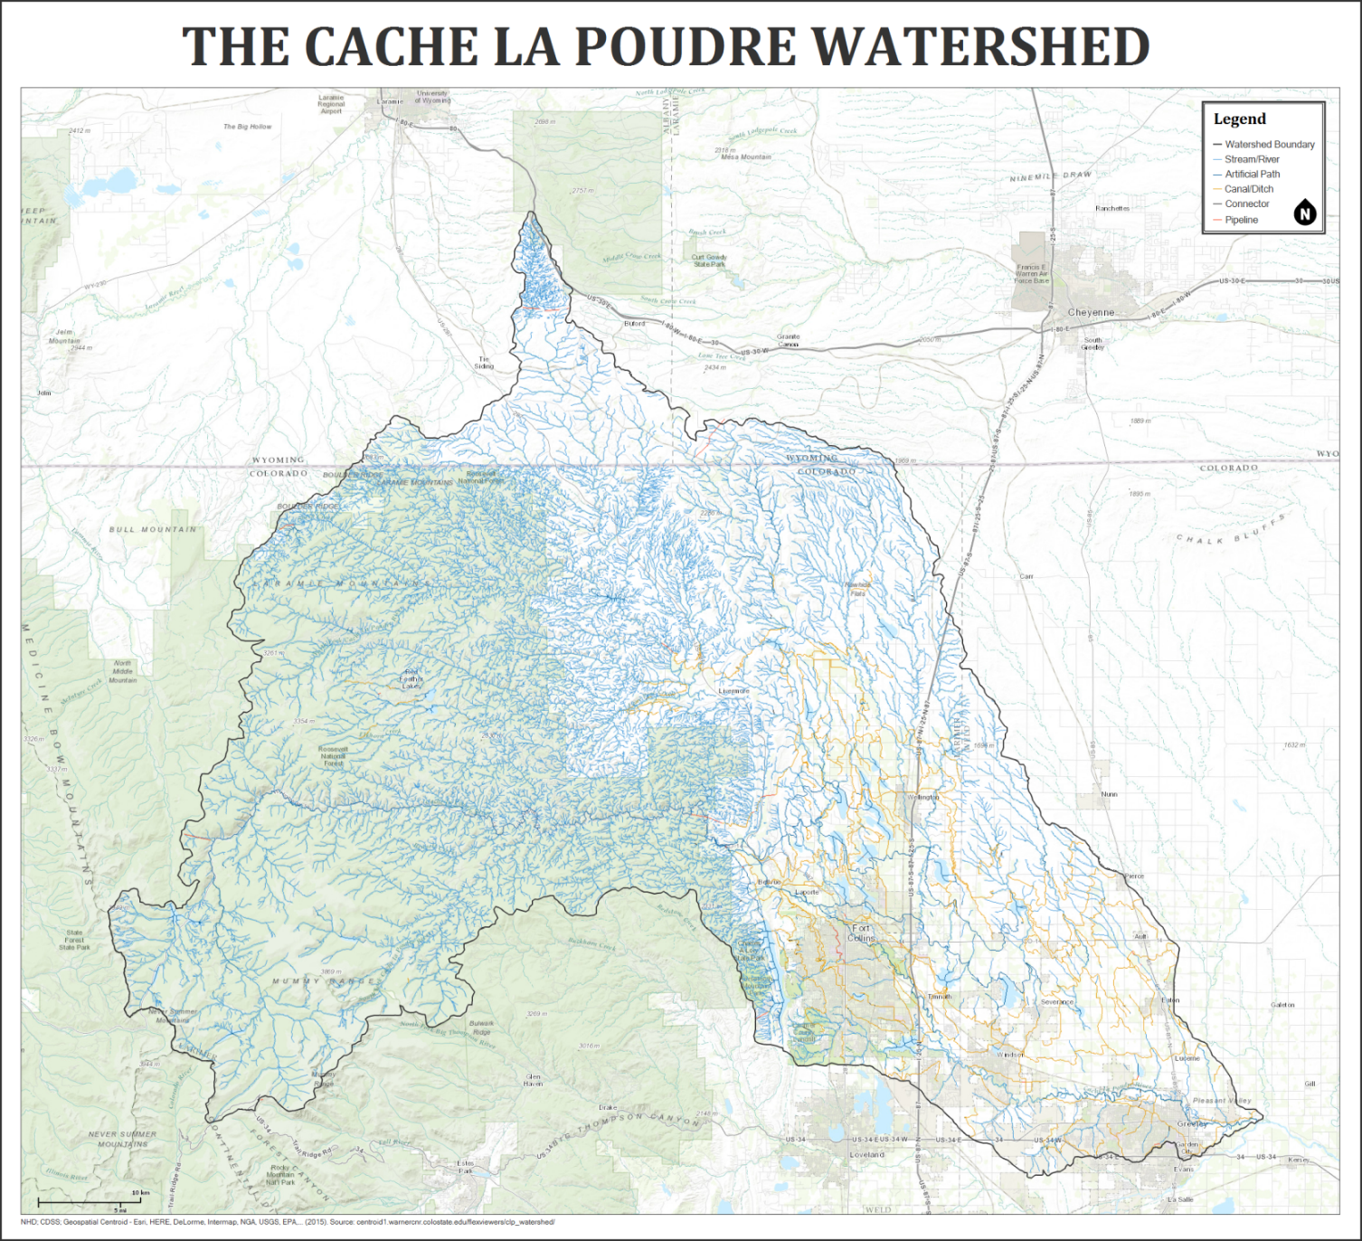
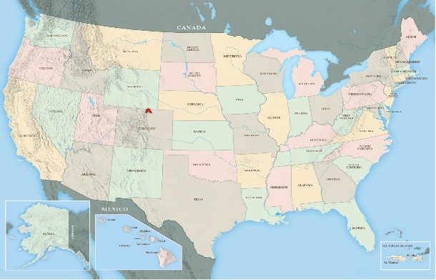
Overview – Geographical Area
http://swmaps.com/wp-content/uploads/2013/01/US_Map_Generic_lg.jpg
Drains an area of 4,895 km²
Elevation Range: 4,590 ft – 10,700ft
Semi-arid Climate
Coniferous forests, shrub and grassland
Urban, rural, cultivated crop, and pasture
Larimer County (84% of watershed area): population ~316,000

Slide 4
Resilience Assessment: Key Findings
In a stage of rapid growth: Large increases in population
Uncertainty of what the future holds
Multiple scenarios: Scenario planning can help predict future conditions
Notes:
When conducting a resilience assessment we found that the Cache la Poudre Watershed seems to be in a stage of rapid growth
The future of the watershed is uncertain because different management approaches can be taken to achieve alternate outcomes
We determined that land ethic and population growth are key drivers that may lead to different scenarios and outcomes within the watershed
Attempting to predict future scenarios can give some insight to stakeholders and may influence management decisions to achieve a specific future condition

Slide 5
Stakeholders | Relative Power | Attitude Towards Environmental Regulation
Energy Producers | High | Negative due to need for resource extraction
Land Owners | Low | Positive due to value of aesthetic beauty
Commercial operators | Low | Negative due to value for development
Recreationalists (non-consumptive users) | Low | Positive due to value for nature
Water Rights Holders | High | Negative due to the need for large water quantity; in-stream flows
Natural Resource Agencies | High | Positive due to interest in protecting natural resources
Notes:
We identified our main stakeholder groups as energy producers, land owners, commercial operators, recreationalists, water rights holders, and natural resource agencies.
Looking at the power or influence each of these groups have we determined that energy producers

Slide 6
Stakeholder Involvement Plan
Community Mapping: informing stakeholders on ecological, economical, and social characteristics of the area
Site Visits: group visits to valued sites
Interdisciplinary Educational Panels: professionals come in to interact with publics and fill gaps in knowledge
Notes:
To get stakeholders involved and informed on the project we developed three main activities
Community mapping would be bringing the stakeholders together to look at a map of the cache la Poudre watershed an learn about the ecological, economic, and social characteristics of the watershed.
Site Visits are used to get the stakeholders out into the field to visit area within the watershed that have been identified as valuable or controversial by the group. This can help create a better understanding among the group members
Interdisciplinary education panels bring in professionals to inform the group of stakeholders on specific topics and can help to fill knowledge gaps within the group and put everyone at the same level of knowledge on important subjects that may influence decisions

Slide 7
Setting the Stage
Focal Question:
What policy and development decisions should the City of Fort Collins adopt to promote sustainability under potential changes in population and water resource use in the Cache la Poudre Watershed in the next twenty years?
Goal:
To inform policy development decisions under a number of possible future outcomes and trajectories
Objectives:
Setting four distinct scenarios
Developing a monitoring plan and identifying signals that indicate the emergence of a particular scenario
Preparing management recommendations based on the given scenario

Slide 8
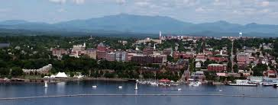
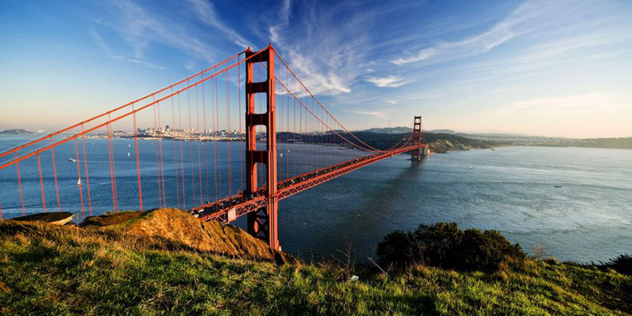
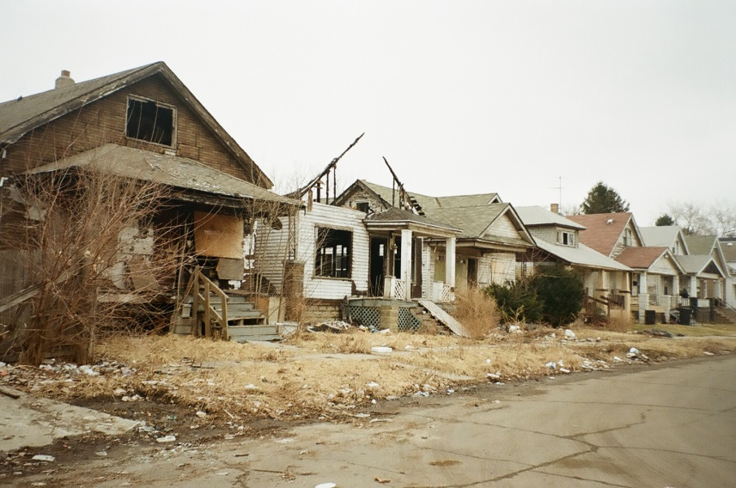
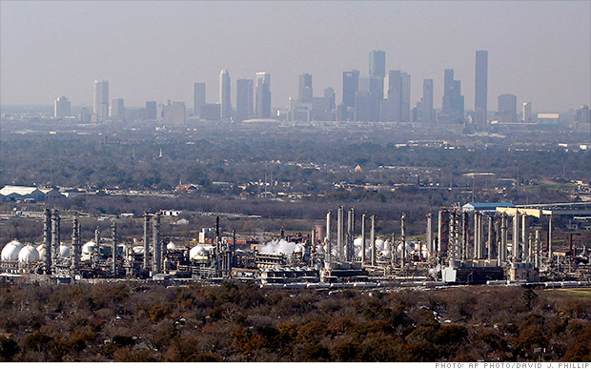
Layout of the Scenario Model
High Land Ethic
Burlington, VT
San Francisco, CA
Low Rate of
Population Growth and
Resource Use
High Rate of
Population Growth
and Resource Use
Detroit, MI
Houston, TX
Low Land Ethic

Slide 9
Monitoring Methods
Quantitative
Census data—demographics and population count
Market Analysis—unemployment rates, consumer preferences, GDP
Qualitative
GIS data on land use composition and resource usage
Market composition—corporate presence, local sourcing, eco-footprints, products/services
Community event listings—farmers markets, CSA, volunteer efforts
Political analysis—legislation, proposed initiatives, city council members
Happiness Index

Slide 10

San Francisco, CA Scenario
Signals
High population growth (> 7% annually)
Prosperous economy—high ingenuity and technological advances
Increase in environmental policies and political activism from community members
Decentralized food and energy production
High business participation in conservation incentives—PES, land easements, sustainable practices
Increase in community-based events—farmer’s markets, entertainment, outdoor recreation, volunteering
Pristine air and water quality—regulation and participation
Decline of NISP project, restored historical flood regime and connectivity of riparian habitat
High wildlife presence and habitat connectivity corridors
Management Recommendations
Concentrated, vertical development
Enforced xeriscaping
Reallocating city/public land for community gardens and composting sites

Slide 11

Detroit, MI Scenario
Signals
Low population growth of (< 3.5 annually)
Unmaintained property and public areas
Outsourced economy, imports
High corporate presence—centralized food and energy production
Dirty, degraded and infrequent natural areas
Poor air and water quality—low environmental regulation
Low community participation and cohesion
Low wildlife diversity and habitat
Approval of NISP project, increase development of aqueducts, loss of riparian habitat
High resource extraction and low environmental regulation
Management Recommendations
Increasing environmental curriculum in school system
Improved maintenance of parks and their supporting facilities
Hosting community oriented events (outdoors)

Slide 12
Houston, TX Scenario
Signals
High population growth (> 7% annually)
Prosperous economy, low unemployment
Increased traffic and motorized transportation
Horizontal expansion of urban development
Increase in policies supporting economic development
High industrial production of exports
Poor air and water quality
Low wildlife diversity and habitat
Approval of NISP project, increase development of aqueducts, loss of riparian habitat
High resource extraction and low environmental regulation
Management Recommendations
Centralized public transportation emphasized on reducing traffic and emissions
Point source pollution cap-and-trade program on waterways
Policy enabling grey water use and the development of necessary infrastructure

Slide 13
Burlington, VT Scenario
Signals
Low population growth (< 3.5 annually)
Local, prosperous economy
High abundance of working lands—adhering to ecosystem needs
Decentralized energy and food production
Strong community cohesion—farmer’s markets, entertainment, outdoor recreation, volunteering
Abundance of natural areas within city limits—parks, trails, waterfronts
Pristine air and water quality—regulation and participation
Decline of NISP project, dam removals, restored historical flood regime and connectivity of riparian habitat
High wildlife presence
Management Recommendations
Increased city acquisitions of land for wildlife corridors (i.e. natural areas with connectivity as an emphasis)
Dam removals
Vegetated waterways in replace of cemented infrastructure

Slide 14
Feasibility and Conclusions
Specific management recommendations are hard to distinguish with high uncertainties
Incentives better for low land ethic scenarios
Regulations better for high land ethic scenarios
High uncertainty regarding population distribution within the watershed

